Slide 1






Introduction
RECRUITMENT, RETENTION AND SUCCESSION PLANNING
Lily Viggiano
Volunteer Canada
Notes:
Lily Viggiano brings 12 years of experience in volunteer engagement to her role as Intergenerational Initiatives Manager at Volunteer Canada, where she mobilizes people from coast to coast to coast to work towards a common good across generations.
Inspired by her family's belief that service and kindness make communities thrive, Lily started volunteering young—from launching her own neighborhood cleanup in elementary school to founding EPYC (Empowering Proactive Youth in Communities).
For her, volunteering creates the purpose, belonging, and meaningful connections that flourish when people come together around shared passions.

Slide 2


Volunteer Engagement Lily Viggiano Ontario Horticultural Association

Slide 3
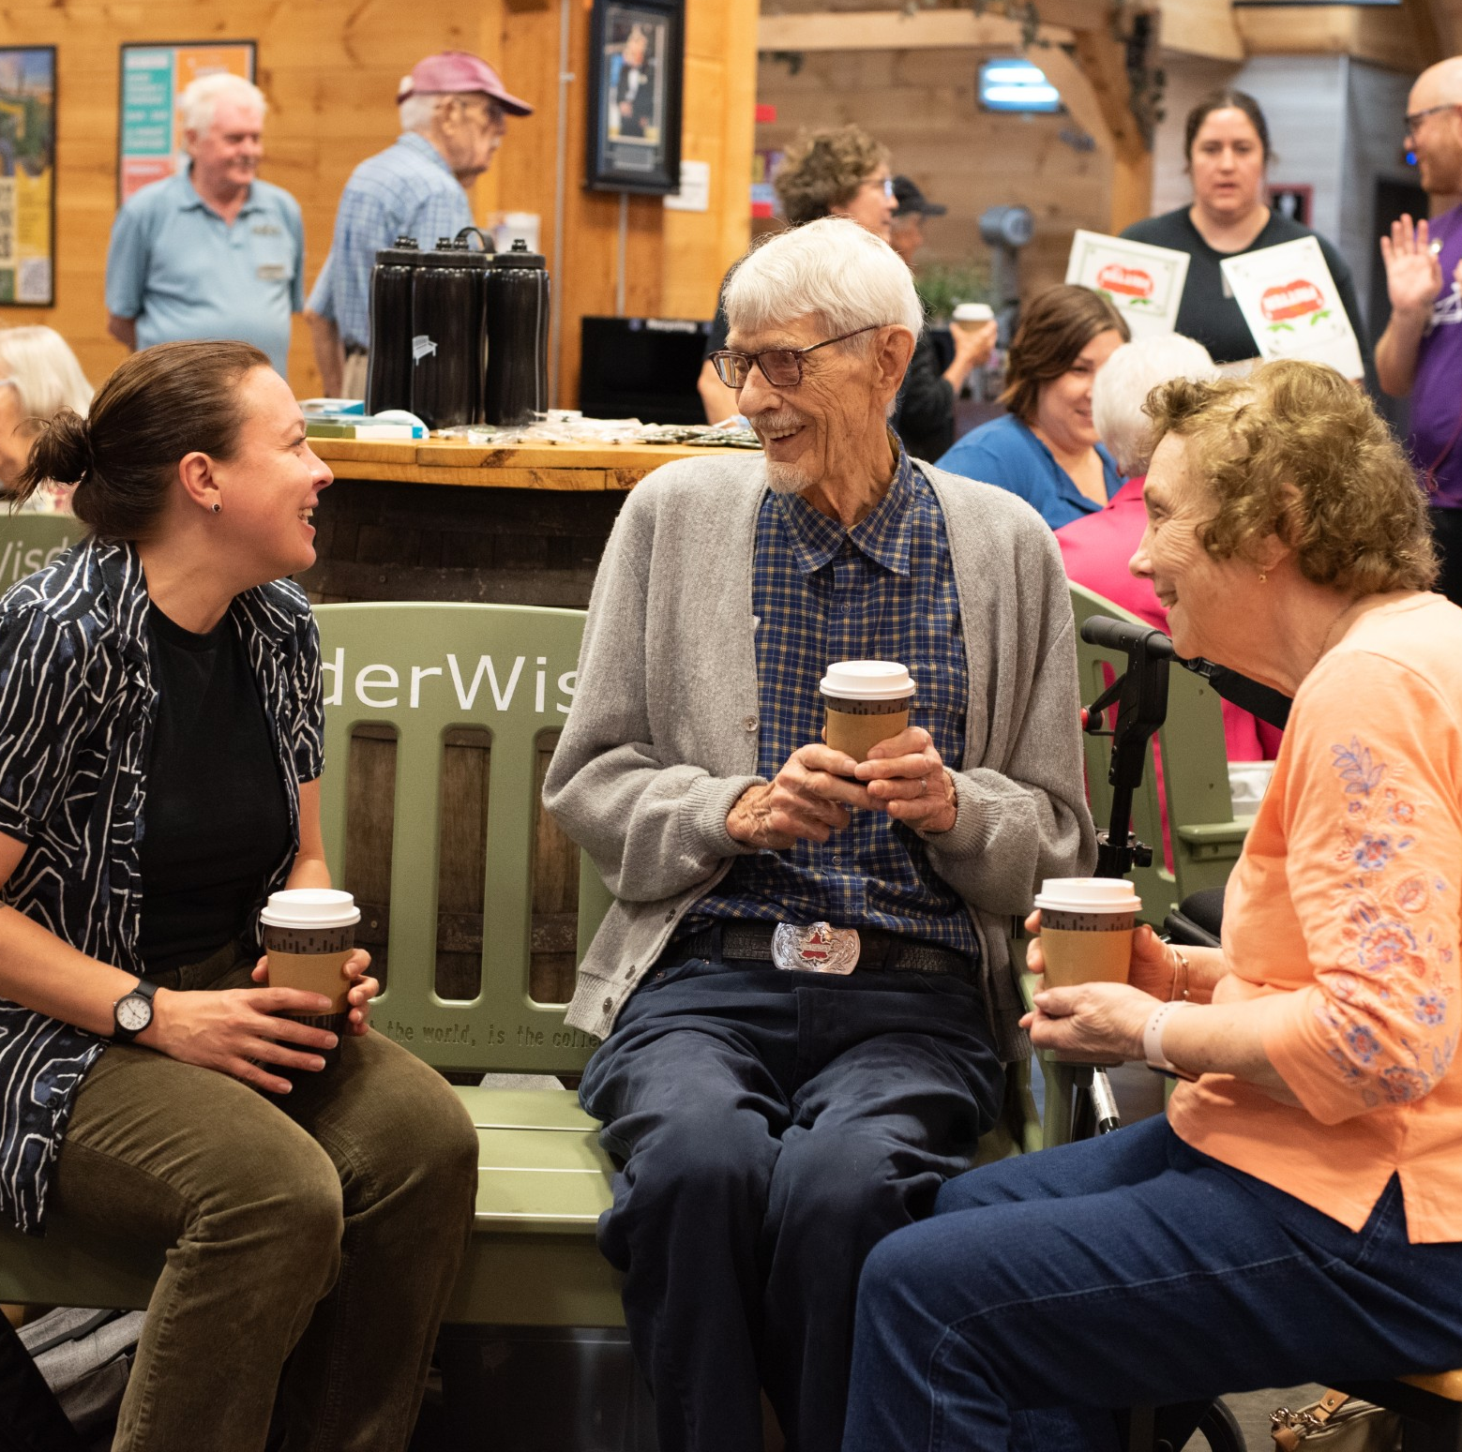
Introduction
Welcome
Context
Purpose of today's Session
Overview of what's ahead
Notes:
Welcome: Lily to introduce herself (qualify)
Context: Acknowledge OHA’s legacy and current challenges (aging volunteer base, leadership continuity).
Purpose of the session: Share evidence-based strategies to recruit younger members, engage current members, build leadership succession, and strengthen long-term resilience.
Quick overview of what’s ahead.

Slide 4

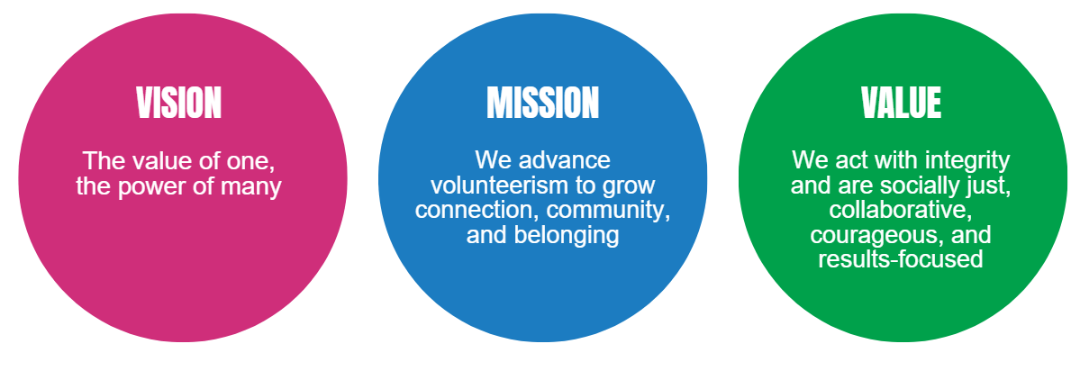
About Volunteer Canada
Volunteer Canada has been convening, connecting, and collaborating since 1977 across sectors to encourage and support volunteerism and meaningful community engagement.

Slide 5

About GenerationsCo
At Volunteer Canada, we envision a Canada where intergenerational connection — intentionally bringing people of all ages together — is recognized as vital infrastructure for resilient, inclusive communities.
Strategic Research and Policy Advocacy
Training and Sector Standards
Field Building and Organizational Support
Knowledge Mobilization and Public Engagement
Notes:
GenerationsCo is the umbrella name for intergenerational initiatives at Volunteer Canada.

Slide 6
Section 1: Recruiting and retaining members
12/6/2025
© Volunteer Canada | volunteer.ca | info@volunteer.ca
Notes:
Volunteer Engagement is at a crossroads: Canadian nonprofits report significantly fewer volunteers and difficulties retaining them post-pandemic. In a 2022 survey, 65% of organizations faced a shortage of new volunteers and 50% struggled to retain those they had. Younger people are volunteering in lower numbers or for shorter durations, while many older volunteers haven’t returned since COVID-19^{2.} Proven strategies to attract younger folks emphasize meeting them where they are – offering flexible, short-term roles, digital engagement, and visible impact. For example, nonprofits have found success using social media campaigns to recruit Gen Z volunteers and by creating “micro-volunteering” projects that fit busy schedules. Equally important is showing volunteers the difference they make: surveys show hearing how their work benefited the cause is the #1 form of recognition volunteers want.

Slide 7

Volunteering is in a state of transition
Findings from the GSS-GVP, 2018-2023 Trends
Volunteer hours (formal and informal) fell from 79% to 73% The average hours per volunteer decreased by 33 hours
Total hours volunteered dropped from 5 billion to 4.1 billion (18%)
Notes:
Volunteering Trends & Challenges: Overall volunteer participation in Canada has dropped markedly. In 2018, 79% of Canadians 15+ volunteered in some form, but by 2022 formal volunteering fell to around 32%. Many organizations report that older volunteers haven’t fully returned after the pandemic and younger individuals prefer ad-hoc commitments over traditional long-term roles. For example, Volunteer Canada noted that younger generations (Gen Z and Millennials) do volunteer at relatively high rates, but they contribute fewer hours on average and favor episodic or project-based stints over steady weekly service. Meanwhile, rural and smaller community groups face additional hurdles – youth often leave for urban centers, exacerbating rural volunteer shortages. Across the board, “recruitment and retention” is cited as a top challenge for nonprofits: Ontario’s 2022 sector survey found more than half of organizations struggled to recruit new volunteers, and 40% had trouble convincing past volunteers to return. This volunteer deficit has real impacts, with many nonprofits scaling back programs or lengthening waitlists for services due to lack of volunteer capacity.

Slide 8
What Volunteers Want
Flexibility and short-term roles
Digital engagement and online sign-ups
Clear impact and purpose
Opportunities for skill-building and networking
Notes:
What Volunteers Want: Today’s young volunteers are motivated differently than previous generations. Surveys indicate youth volunteer for causes they’re passionate about, to gain experience, and to meet peers – but they insist on flexibility and impact. A Government of Canada exemplary practices guide observed that “the current cohort of 18–25 year-olds is enthusiastic and capable… they tend to volunteer episodically and need to see the impact of their work to stay engaged”. In other words, young people will enthusiastically rally around a cause, but they expect convenient, well-defined roles with visible results. They also respond to social and career benefits: research for Volunteer Canada noted 45% of volunteers (across ages) cite gaining skills/experience as a reason they volunteer, and Forbes’ Nonprofit Council experts emphasize leveraging this by offering “micro-volunteering” or skill-based projects that help build résumés³⁶. Another powerful draw for younger demographics is peer networking – one successful tactic is engaging college students through campus programs or having youth serve as volunteer ambassadors to recruit their friends. Not least, technology is key: younger volunteers live online, so outreach via social media, and providing digital ways to volunteer (remote tasks, app-based sign-ups), is crucial. For instance, volunteer managers in one engagement session shared that Instagram campaigns and a strong online presence helped them reach diverse youth audiences in ways traditional methods hadn’t.

Slide 9
Recruitment Strategies that Work
Partner with schools, colleges, and youth groups
Have an online prescence
Offer “micro-volunteering” and skill-based roles
Create peer-led ambassador programs
Notes:
Effective Recruitment Strategies: Several recurring best practices emerge for recruiting volunteers, especially younger ones, backed by both internal insight and external case studies:
Leverage Social Media & Modern Outreach: Go where young people are. Use Instagram, YouTube, and campus networks to showcase volunteering. Equip passionate supporters as ambassadors, providing them toolkits to promote opportunities online and set up opportunities for current members to bring "family, friends, and peers". When an organization “meets volunteers where they are,” engagement rises.
Emphasize Flexible Commitments: Many people hesitate to volunteer due to time constraints. Offering bite-sized volunteering options (one-day projects, micro-tasks, or episodic roles) lowers this barrier. Volunteer experts recommend creating “micro-volunteering” assignments and short-term projects that can be done in a few hours. Prehaps this looks like engaging folks in season opener or season closer projects/days for local level needs. Skills-based volunteering is another draw – invite younger professionals to contribute their expertise in IT, marketing, design, etc., on a project basis. This aligns with trends in corporate volunteering too, where employees seek meaningful, skill-aligned ways to help.
Show Impact and Purpose: Today’s volunteers, especially millennials and Gen Z, want to see the tangible impact of their contribution. It’s crucial to communicate how volunteers’ work affects the mission. Share success stories and data (“your efforts helped 100 seniors receive meals this week”) and connect volunteers directly with beneficiary stories. The top way volunteers wish to be thanked is hearing how their work made a difference. Conversely, impersonal recognition (banquets, generic certificates) is far less motivating. Ensuring each volunteer understands their value boosts both recruitment (through word-of-mouth) and retention.
Simplify Entry and Reduce Barriers: Streamline the process of becoming a volunteer. Long application forms, slow responses, or onerous screening can turn busy people away. Where possible, offer easy online signup, clear role descriptions, and quick onboarding. Some organizations are revisiting requirements like police checks or training – balancing risk with accessibility. (One policy idea from the sector: remove fees for vulnerable sector background checks to encourage more sign-ups⁴⁶.) “Make it as easy as possible for them to become an ambassador”, advises one nonprofit CEO – have ready-made tasks or campaigns that new volunteers can plug into with minimal hassle⁴⁷.
Targeted Outreach & Inclusion: To broaden the volunteer base, targeted recruitment is useful. For instance, engaging youth through schools and volunteer credit programs (high schools in Ontario require volunteer hours for graduation), or partnering with newcomer groups to involve immigrants (who often want to build networks through volunteering). Every demographic has potential: families can be drawn in by family-friendly volunteer days, seniors by social opportunities, etc. The key is to craft messages that speak to each group’s motivators. An academic study on youth volunteering finds that messaging which appeals to youths’ desire for social connection or career growth yields better recruitment results than generic asks.
Opportunities for Leadership and Voice: A savvy strategy is to give young volunteers a voice in the organization. This can mean forming youth advisory committees or even adding youth positions on the board. By including younger volunteers in decision-making, an organization signals it genuinely values their input – which can dramatically increase engagement and also help with succession (seeding future leaders). One of Forbes’ recommended tactics is literally “Add Youth to Your Board”, which both empowers youth and helps the nonprofit stay relevant to next-generation perspectives.

Slide 10
Retention Strategies that Work
Provide meaningful orientation and training
Assign volunteer managers
Recognize contributions informally and often
Match volunteers to roles that fit their interests
Notes:
Retention & Engagement Practices: Recruiting volunteers is only half the battle – keeping them is critical for long-term success. Several evidence-backed approaches improve retention:
Quality Orientation and Training: Volunteers are more likely to stay if they feel prepared and capable in their roles. Providing a warm orientation, necessary training, and a buddy/mentor for new volunteers helps them integrate. Retention starts on day one. If volunteers feel lost or ineffective early on, they disengage. Giving them the tools to succeed (even a basic welcome session and clear handbook) boosts confidence and commitment.
Volunteer Management and Support: Organizations that dedicate resources to volunteer management see far better retention. During the pandemic, many nonprofits cut volunteer coordinator roles; those that didn’t were far more successful in keeping volunteers engaged. A Volunteer Toronto study found that nonprofits with a volunteer manager retained 16 times more volunteers than those without. The lesson: having staff or experienced volunteers to oversee scheduling, address concerns, and keep volunteers feeling appreciated is invaluable. Support also means soliciting feedback – checking in with volunteers and showing responsiveness to their suggestions or needs.
Recognition and Social Belonging: Beyond formal recognition events, ongoing appreciation is key. Simple, frequent thank-yous and highlighting volunteer contributions publicly (in newsletters, social media spotlights) reinforce a sense of purpose. Volunteers also tend to stay where they form friendships and community. Facilitating a social element – e.g. team-building gatherings, coffee chats, or peer recognition – can turn volunteering into a rewarding social outlet. Many younger volunteers report volunteering to combat loneliness or find like-minded peers. Fostering a welcoming, inclusive team culture will naturally improve retention.
Matching Interests and Skills: Whenever possible, align volunteers with work that taps their interests or skills. An internal Volunteer Canada framework notes that modern volunteer engagement is about “individualizing the volunteer experience and centering human connection in the volunteer recruitment pipeline”. Volunteers who find their niche – a task they excel at or care deeply about – tend to volunteer longer and with greater output. If a volunteer starts in a role that isn’t a good fit, consider reassigning them rather than losing them. Some organizations create “volunteer development plans” akin to staff development, to help volunteers grow into roles they’ll love.
Addressing Common Barriers: Retention can falter if volunteers encounter avoidable frustrations like disorganization, lack of resources, or feeling unsafe. Ensuring your volunteer program is well-organized (clear schedules, defined roles, point of contact for help) makes volunteers more likely to stick with it. Also, be mindful of issues like out-of-pocket costs (provide transit vouchers or meals for volunteers if you can) and volunteer burnout. Don’t overload the willing with too much work – respect volunteers’ boundaries so they don’t burn out and quit. Especially for critical, long-serving volunteers, check that they’re comfortable with their workload. Offering breaks, backup support, or rotation can help sustain them.

Slide 11
Ideas to consider for OHA recruitment
Horticultural Society – what’s in a name?
Host special events and learning series to encourage new folks to join, while deepening the connection with current members who may lead or support such activities
Group volunteering for the garden opening and closing periods (classrooms, youth groups, Men’s Sheds/service clubs, employer-supported volunteerism)
Are there more ways to get involved than in the garden? Share this information.
Warm welcomes always, personal invites, and managing expectations are KEY
Notes:
High-Impact Insight: One telling statistic from Statistics Canada shows the generational shift in volunteering: In 2018, 52% of Gen Z (age ~15-24) volunteered formally, a higher participation rate than older groups – but their average annual hours were only ~82, versus 222 hours for the oldest generation⁷³. This confirms that younger volunteers are willing but in shorter bursts, so organizations must engage more youth to make up hours, and structure opportunities to fit smaller time allotments. The decline in hours also reflects youth juggling more commitments (work, gig economy, studies) in today’s climate.⁷⁴ ⁷⁵

Slide 12
Ideas to consider for OHA retention
Warm welcomes always, personal invites, and managing expectations are KEY
Encourage leadership at special events, learning series and group volunteering
Volunteer development plans
Time limit on commitments (1 year)
Ask for feedback – and then use it. Close the loop.

Slide 13
Section 2: Leadership Succession Planning
12/6/2025
© Volunteer Canada | volunteer.ca | info@volunteer.ca
Notes:
Leadership succession planning is weak across the sector, posing a risk to long-term stability. Fewer than one-third of nonprofits have a formal succession plan in place, even though many organizations report their senior leaders and board members are nearing retirement. This gap threatens continuity – for instance, 42% of nonprofit CEOs in one province had been in their role under 3 years, reflecting high turnover and fragile leadership pipelines. Best-practice frameworks stress the need to identify and groom future leaders well before transitions. This includes establishing written succession plans for emergencies and planned departures, mentoring younger staff/volunteers, and cross-training people so that no critical function relies on a single person. Organizations that invest in leadership development and mentorship report stronger continuity and smoother handovers.

Slide 14

Why Succession Planning Matters
Only ~30% of nonprofits have formal plans
High turnover among volunteer leaders
Risk of knowledge loss and disruption
Succession = continuity and resilience
Notes:
Canadian data mirror this: The Provincial Volunteer Sector Profiles report (2025) found that in Prince Edward Island, only 32% of nonprofits had any succession plan, and only ~38% in Nova Scotia did. An Ontario survey likewise noted succession planning as a weak point for many organizations. The lack of planning is worrisome given leadership demographics: nonprofit board members and volunteer leaders tend to be older, and turnover is accelerating. For instance, 42% of nonprofit CEOs in PEI had been in their role under 3 years, suggesting a wave of recent departures and new, perhaps less-experienced leaders taking the helm. Moreover, many nonprofits (especially small ones) rely heavily on the passion and knowledge of one or two individuals – if those individuals step down without a successor ready, the organization could flounder. Only 12% of Ontario organizations felt confident they had someone to fill key leadership roles internally if a leader left.

Slide 15
Succession Planning Framework
Emergency succession plan
Planned transition strategy
Cross-training and documentation
Mentorship and leadership development
Notes:
Frameworks and Tools for Succession Planning: Succession planning doesn’t mean you’re pushing out current leaders; it means building a pipeline and safety net for whenever transitions occur. Key components of effective succession planning include:
Emergency Succession Plan: A document outlining what to do if a leader leaves unexpectedly (e.g., due to illness or resignation with little notice). It typically names an acting/interim leader (or process to designate one), lists critical tasks and who can cover them, and has a communications plan for stakeholders. The National Council of Nonprofits advises every nonprofit to adopt an emergency leadership transition plan so that authority and duties are immediately clear in a crisis. For example, it might specify that the Board Chair or Operations Director steps in as interim ED, and that key funders will be notified within 48 hours with assurance of continuity. Having this in place can turn an abrupt departure from a catastrophe into a manageable change.
Planned Succession Strategy: For anticipated transitions (retirement, term limits, etc.), it’s wise to create a timeline and process well in advance. This includes deciding when to announce the transition, how to form a search or selection committee, and how the outgoing leader will help hand over knowledge. NCN suggests engaging the board and staff 1–2 years ahead for a long-tenured leader’s planned exit. A timeline might look like: T–12 months: leader announces plans to depart; T–11 months: board identifies required leadership qualities for next phase; T–9 months: begin search (or grooming internal successor); T–3 months: hire new leader overlap period; T=0: new leader fully in place, former leader ceremonially departs (after onboarding successor). Of course, if promoting from within, the timeline might focus more on training and gradually elevating the successor.
Cross-Training and Knowledge Transfer: Succession planning isn’t just about the top job. It’s about ensuring critical knowledge and relationships are shared beyond one person. Forward-thinking associations document key processes and have deputies or teams shadow leaders in essential areas. For instance, if one volunteer handles all membership records, make sure another person is trained on that system. If the executive director has all the grant contacts, those should be logged in a central database that others can access. Cross-training staff and board members creates a “deeper bench” so the organization isn’t left scrambling if someone leaves. Some organizations implement periodic rotations or backups for leadership tasks specifically to maintain redundancy (e.g., the board vice-chair might periodically run meetings to be ready to step in). As the Nonprofit Risk Management Center puts it, building resilience means avoiding single points of failure – have backups for important operations and leadership roles.
Leadership Development and Mentorship: Identify high-potential individuals and actively prepare them for future leadership. This might involve sending them to leadership training, giving them stretch assignments, or pairing them with current leaders as mentees. A culture of mentorship helps transfer knowledge. For example, a long-time volunteer coordinator could mentor a younger volunteer in how to run the annual plant sale, gradually handing over the reins. In PEI, a recommendation was to “promote mentorship between senior nonprofit leaders and younger professionals” to strengthen the pipeline. Organizations can formalize this by establishing a mentorship program or “deputy” roles.
Board and Committee Involvement and Diversity: For volunteer-led organizations, the board or committee succession is equally critical. Only about 42% of Canadian nonprofits report they have an easy time recruiting qualified board and committee members. Succession planning should cover board/committee renewal: setting term limits, recruiting new members regularly, and cultivating future board leadership (e.g., a board chair-elect system). Diversity is key here – bringing in younger or demographically diverse board members well before all the current ones retire ensures continuity and fresh perspective. Provincial profiles highlight that many boards are older and not reflective of community diversity, and they urge targeted efforts to recruit underrepresented groups onto boards. Including this in the plan (e.g., “each year identify 2-3 prospective board candidates from younger demographics or diverse backgrounds”) can future-proof leadership.
Updating Governance Policies: Incorporate succession into bylaws or policies. For instance, have a policy that the Vice Chair is the presumptive interim Chair if the Chair cannot serve, or that the Executive Director must develop an internal succession plan for key staff. Some organizations conduct an annual talent review at the board level to discuss who could step up if needed for each leadership role – normalizing this conversation reduces stigma and keeps succession on the radar.

Slide 16
Succession Planning In Practice
Identify critical roles and backups
Create a leadership timeline
Engage younger members in governance
Use board term limits and chair-elect roles
Notes:
Start by identifying essential functions vs. non-essential – know which roles or tasks absolutely must continue without interruption to keep the organization running¹⁰⁵. This helps prioritize succession efforts on critical areas.
Implement multi-level succession: Don’t just plan for the President; plan for department heads, project leads, and key volunteer leaders as well. This broad approach builds depth.
Create protocols for interim leadership – have a plan for who steps in temporarily for major roles (not just top positions, but say if the finance manager leaves, who covers?).
Thorough documentation: Ensure executive responsibilities, key contacts, and procedures are clearly documented so someone new can pick them up.
Board/Committee collaboration: The board should treat succession as a strategic priority, not a taboo. Wipfli suggests boards establish dedicated committees for leadership development and integrate succession planning into strategic plans.
Professional development as pipeline: Integrate succession with team development—train and empower teams so that you organically have people ready to advance. This also boosts retention as teams see growth opportunities.
Address generational transition: Many associations rely on veteran leaders and find younger professionals aren’t as interested in stepping up under current conditions. Research suggests making leadership roles more appealing (flexible schedules, co-leadership models, phased retirements for outgoing leaders to ease handover) to attract next-gen talent.

Slide 17
Ideas to consider for OHA succession
Term lengths for committee positions
Matching younger and older people together
“co-positions” – partnering up on bigger roles
Notes:
For example, CCVI emphasizes that volunteer programs should have policies and record-keeping – which ties into documenting roles for succession. We might note that aligning with these standards (and referencing them in the presentation) could strengthen OHA’s case that it’s following established best practices.

Slide 18
Section 3: Building Long Term Resilience
12/6/2025
© Volunteer Canada | volunteer.ca | info@volunteer.ca
Notes:
Building organizational resilience requires addressing those first two challenges while also fortifying the organization’s capacity to adapt. Volunteer-powered organizations are inherently at risk if volunteer engagement and leadership continuity falter, as seen during COVID-19 when 62% of Ontario nonprofits lost volunteers and half could not resume all services. To strengthen resilience, nonprofits are pursuing strategies like diversifying their volunteer base (engaging youth, families, newcomers to fill gaps), modernizing volunteer management practices (e.g. adopting online volunteer platforms; reinstating volunteer manager roles, which can boost retention up to 16×), and planning for continuity (documenting processes, creating backup plans for sudden departures, and building financial reserves). At a sector level, there’s a push to align with Volunteer Canada’s best practices and initiatives – for example, Volunteer Canada’s forthcoming National Volunteer Action Strategy explicitly aims to “future-proof volunteerism” and build the infrastructure for resilient volunteer engagement across the country.

Slide 19

What is resilience?
Ability to adapt, survive, and thrive
Responding to shocks (e.g., pandemic, turnover)
Maintaining mission and services under pressure
Notes:
Context – Why Resilience is Pressing: The past few years have tested nonprofits’ resilience like never before. The pandemic, economic uncertainty, and social shifts created a “perfect storm” of increased service demand and reduced capacity. In Ontario, 74% of nonprofits saw demand for services jump in 2022 while at the same time over half faced revenue declines or stagnant funding. Many organizations faced tough choices: nearly 86% had to cut back programs, increase waitlists, or even discontinue services due to staffing/volunteer shortages and funding issues. Furthermore, one-third of Ontario nonprofits knew of peer organizations that had permanently closed due to the pandemic’s impacts – a stark indicator of fragility. This experience has heightened awareness that long-term resilience isn’t abstract – it’s survival. For OHA and similar associations, resilience means being able to continue fulfilling their mission (promoting horticulture, engaging communities) despite volunteer turnover, financial ups and downs, or external crises.

Slide 20
Building Resilience
Diversify volunteer base and leadership
Invest in volunteer infrastructure
Embrace digital tools and flexible models
Leadership and Governance strength
Notes:
Key Pillars of Organizational Resilience:
Robust Volunteer Engagement System: Since we’ve covered volunteer recruitment/retention, we’ll summarize: A resilient organization has a stable core of volunteers and the ability to continually attract new members. Volunteer Canada describes a vision of “an enabling volunteering environment” where infrastructure supports make it easy for people to participate. Concretely, this means having processes and tools to recruit, train, and manage volunteers efficiently (e.g., a good database, clear volunteer roles, recognition programs). It also means being inclusive: reaching out to diverse groups (youth, seniors, different cultural communities) to broaden the volunteer pool, so that the organization isn’t overly dependent on one demographic. Diversity in volunteers can reduce vulnerability – for instance, if one age group or cohort faces constraints (as happened when many seniors paused volunteering due to COVID risk), another group can step up. Intergenerational volunteer programs are one idea: pairing younger and older volunteers so they support each other and share knowledge, which Volunteer Canada has promoted to combat the “loneliness epidemic” and volunteering crisis simultaneously.
Adaptability and Innovation: Resilient organizations are flexible. They monitor changes in their environment and adapt programs or strategies accordingly. One example: during COVID, many charities pivoted to virtual programming and remote volunteering. Those that embraced new technology and methods could continue their mission (albeit differently), whereas those that couldn’t adapt had to suspend operations. An internal insight was that COVID “accelerated digital adoption, with 61% of nonprofits increasing use of technology” and that digital capacity is now a factor in resilience. For OHA, this might mean being open to hybrid meeting formats, online engagement of members, or using social media not just for volunteer recruitment but for delivering educational content (if in-person events are disrupted). Investing in training (for leaders, volunteers, board) on new skills – be it technology, fundraising techniques, or diversity & inclusion – also boosts adaptability. Another form of innovation is programmatic: re-imagining volunteer roles (like creating micro-roles or family volunteer days as noted) to respond to societal trends. The ability to try new approaches and learn (even from failures) is a hallmark of resilient culture. Encourage experimentation on a small scale to continuously improve engagement.
Leadership and Governance Strength: We’ve addressed succession – beyond that, good governance itself is crucial. A well-functioning board that regularly engages in strategic planning, risk management, and oversight will foresee challenges and guide the organization through tough times. The Nonprofit Risk Management Center emphasizes fostering a “culture of candor, trust and mutual support” within leadership. If members and board can discuss problems openly (rather than hide issues until they explode), and if the organization is honest with itself about weaknesses, it can take corrective action early. Part of governance for resilience is also monitoring key indicators (volunteer satisfaction, membership trends, financial ratios) and having contingency plans (for disasters, loss of facility, etc.). For example, an organization might have a continuity plan for data and files (backups, cloud storage) so that if an office is inaccessible, work can continue – this is basic, but often overlooked until a crisis hits (like a flood or fire).

Slide 21
Partnerships and Networks
Collaborate with Volunteer Centres/municipalities
Partner with schools, businesses, and other clubs
Share resources and best practices
Notes:
Networking and Partnerships: No nonprofit is an island; those with strong networks tend to be more resilient. Collaborating with other organizations can allow sharing of resources, collective problem-solving, and mutual aid in times of crisis. For example, horticultural clubs could partner with local youth groups or environmental orgs for joint volunteer projects – diversifying who is involved and building community support. The sector is recognizing the value of networks: The ONN called for “coordinated sector responses” and better sector–government coordination to tackle systemic challenges. On a micro level, OHA could strengthen ties with Volunteer Canada resources, Volunteer Centres in Ontario, or similar associations (like other provincial horticultural or master gardener groups) to exchange best practices. Community partnerships (e.g., with a college horticulture program, local business, or social group) can also inject new support. In resilience terms, having multiple allies and supporters means the organization has places to turn for help or advice when facing difficulties, rather than being isolated.

Slide 22
Case Examples
Succession bench
What-if exercises
Invest in volunteer infrastructure
Knowledge capture
Well-being and burnout prevention
Sector and community connections
Notes:
Succession bench for key volunteer roles: Identify 2-3 critical volunteer-led roles (e.g., event organizer, youth outreach lead) and ensure each has an assistant or committee member who could step up. This diminishes dependency on any single person.
“What-if” exercises: Have the board brainstorm scenarios (“What if our membership drops 20%?”, “What if we have to cancel in-person meetings for a year?”, “What if our longtime treasurer leaves?”) and come up with response strategies. This kind of scenario planning can later be distilled into actual policies or contingency plans.
Invest in volunteer coordinator position: If not a staff hire, perhaps a dedicated volunteer leadership role – someone who focuses on keeping volunteers engaged, checking in, organizing recognition. As noted, having that function greatly improves volunteer retention (and hence resilience).
Knowledge capture: Start compiling procedure notes for recurring activities (how to run the annual flower show, how to manage the email newsletter). These “playbooks” ensure continuity if the usual lead is unavailable. Encourage experienced members to share their wisdom in writing or group training sessions.
Well-being and burnout prevention: Resilient organizations care for their people. Encourage a healthy balance – e.g., rotate demanding duties among volunteers, ensure no one is overextended. Also foster an environment where volunteers or staff can voice when they are struggling, so the group can adapt. The ONN report quote about volunteers “burnt out from picking up the slack” is a red flag scenario to avoid.
Community connections: Build relationships with entities like local volunteer centres and local municipalities if eligible, which can be allies in recruiting new volunteers or providing training. Also link with Volunteer Canada’s resources – e.g., the Canadian Code for Volunteer Involvement (CCVI) as a framework to assess and improve volunteer program practices (using CCVI’s audit tool can highlight areas to strengthen, thereby increasing resilience).

Slide 23
Section 4: Summary + Q&A
12/6/2025
© Volunteer Canada | volunteer.ca | info@volunteer.ca

Slide 24

Summary and Key Takeaways
Recruit and retain with flexibility and purpose
Plan for leadership transitions early
Build resilience through people, planning, and
partnerships
Align with sectoral best practices

Slide 25
Call to Action
Start small: pilot one new tactic
Share learnings across OHA Districts,
Societies/Clubs
Connect with sectoral and municipal partners
Build a culture of sustainability and inclusion

Slide 26
Questions and Discussions
Floor now open for questions and discussions
Notes:
Lily prompts
* What’s worked for your society in recruiting younger members?
* How are you preparing for leadership transitions?
* What resilience challenges are you facing locally?

Slide 27

THANK YOU
Notes:
Lily Viggiano, Intergenerational Initiatives Manager
Lviggiano@volunteer.ca
www.volunteer.ca

Slide 28

Thank
You

